Slide 1
FOD 490 Final Presentation
Chi A, Jacob Belz, and William Doyle

Slide 2
Purpose
Purpose
Extending proof of concept of detecting FOD on an airport runway through Computer Vision (CV)
Provide a client server solution through the browser to allow various airports to use our system.
Notify airports (users) of FOD when detected
Keeping runways clean to reduce delays and repair costs

Slide 3
Background ***
FOD related issues cost airlines and airports $12 Billion in delays and repair costs yearly
Each FOD damage incident is in the millions of dollars for repairs alone
Types of FOD and how they occur
How FOD is detected now (large vs smaller airport and military)
How Fod is cleaned now
Where our solution comes in

Slide 4
Scope
The ability to detect FOD on the runway including:
Bolts, screws, tools, people, animals, and any other large debris (tentative list as we evaluate most relevant FOD for MSP or other regional airports)
The implementation of a machine learning model to recognize FOD
The software performance being able to keep up with live FOD detection
The delivery of reliable FOD analytics
User friendly software intended for airport personnel
The ability to place detections on a live map

Slide 5
Intended Audiences
Intended for Small-Med Civilian Airports
Airports - Reduce costs of operations and customer delays
Runway staff and personnel – Automating aspects of their work
Air Traffic controller – Better Informed of ground conditions
Aviation Enthusiasts
CV Enthusiasts

Slide 6
Functional Requirements
REQ-1: Have a camera(s)
REQ-2: Connect to the camera(s)
REQ-3: Have our software running
REQ-4: Have a GPS device connected
REQ-5: The object must first be detected
REQ-6: The object must be trained into the software
REQ-7: The object must be in the list of what we have trained
REQ-8: Software must be trained
REQ-9: Software should give location on where the object is
REQ-10: Software must have a bounding box around the object

Slide 7
Non Functional Req.
FOD is detected as soon as possible but in no more than 5 minutes (real time detection)
Mitigate false negative rate as low as possible. False negative can cause an accident, false positives cannot.
Detection model and back end should only be altered by admins
The app should be easy to install and maintain
App is hosted in a cloud based format allowing cameras to connect wirelessly
The app is reliable with as much uptime as we can achieve

Slide 8
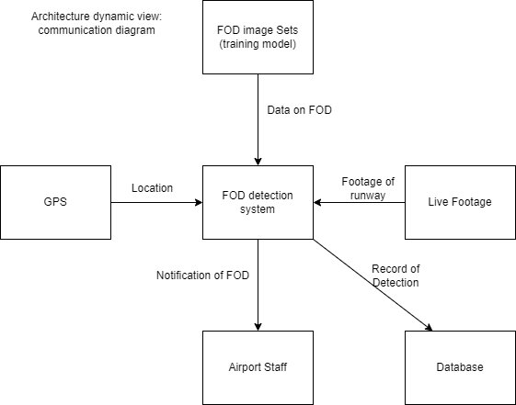
Context Model

Slide 9
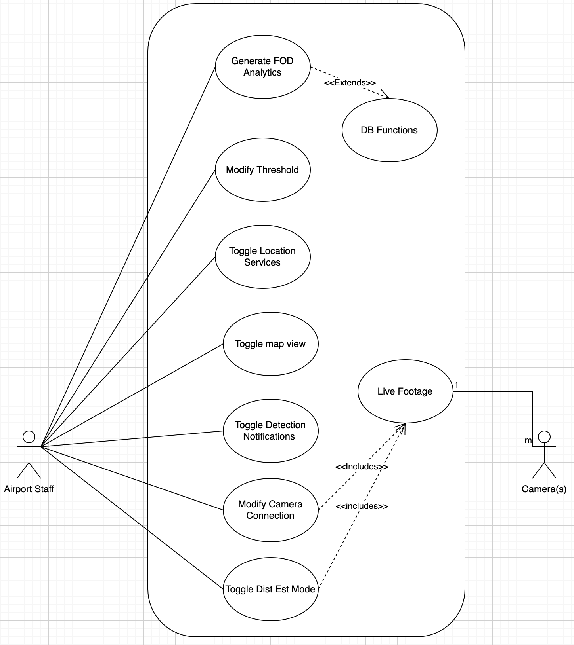
Use Case Models

Slide 10
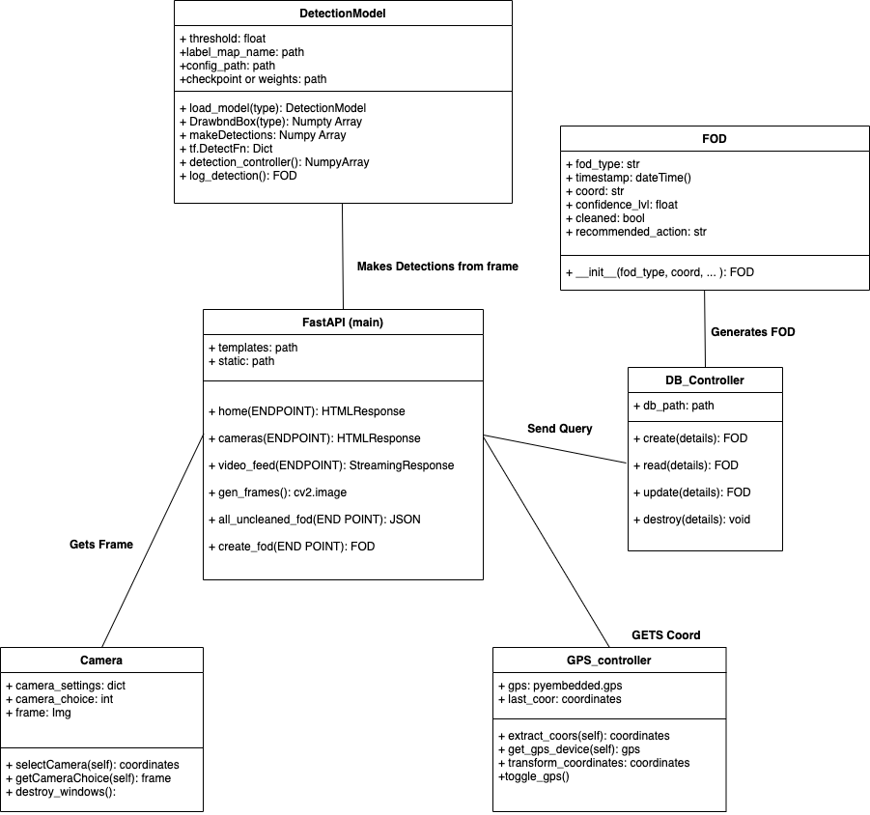
Class Diagram

Slide 11
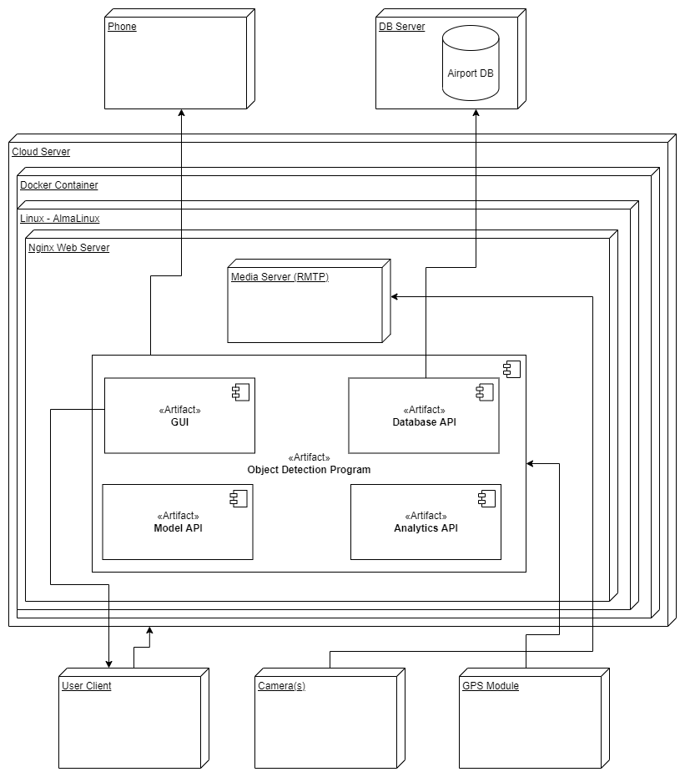
Deployment Diagram

Slide 12
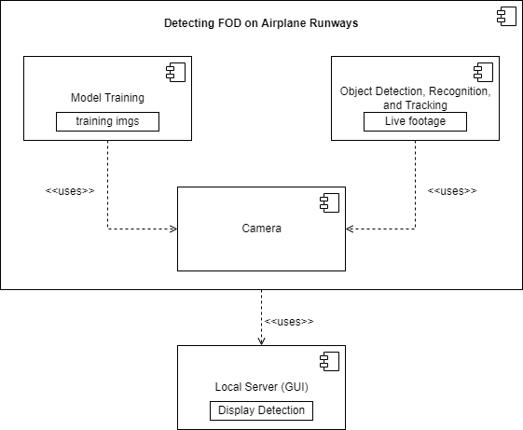
Structural View

Slide 13

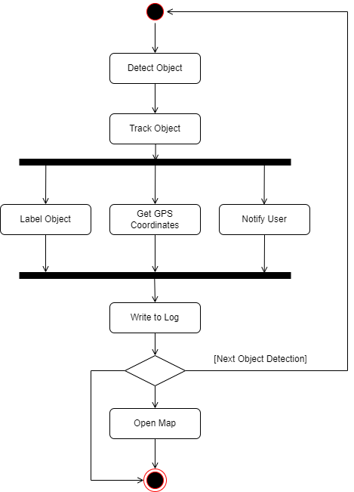
Activity Diagram

Slide 14
Original State of Project
~30-45 second startup time and 3-5 sec inference speed
Using SSD_Mobilenet_v2_FPN_320x320 arch.
Class labels included the following: gloves, luggage tags, wood, metal, pens, wood
Heavily imbalanced in favor gloves, luggage tags and wood
Frame stuttering
Gui made using PySimpleGui in the form of a desktop application
Stateless logging of FOD detection
Demo showed multi-cam connectivity but unable to recreate on our machines
Saved Fod on Leaflet map with image
Great proof of concept
Kind enough to grant us a project handoff file and gave us good training files and learning resources

Slide 15
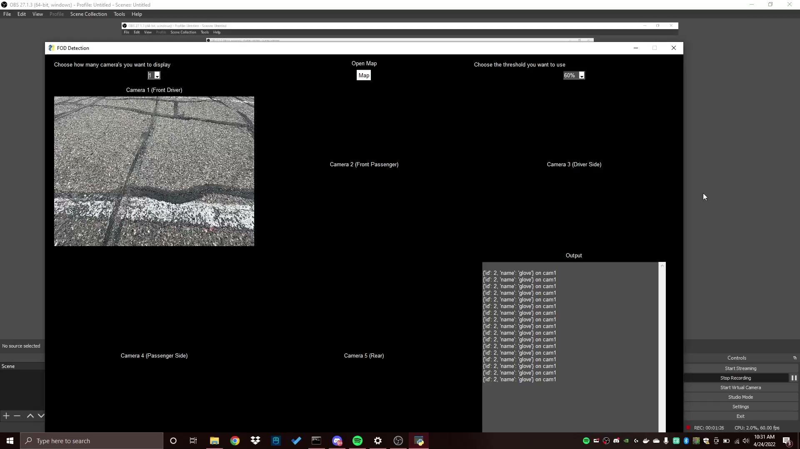
Original State of Project (cont.)

Slide 16
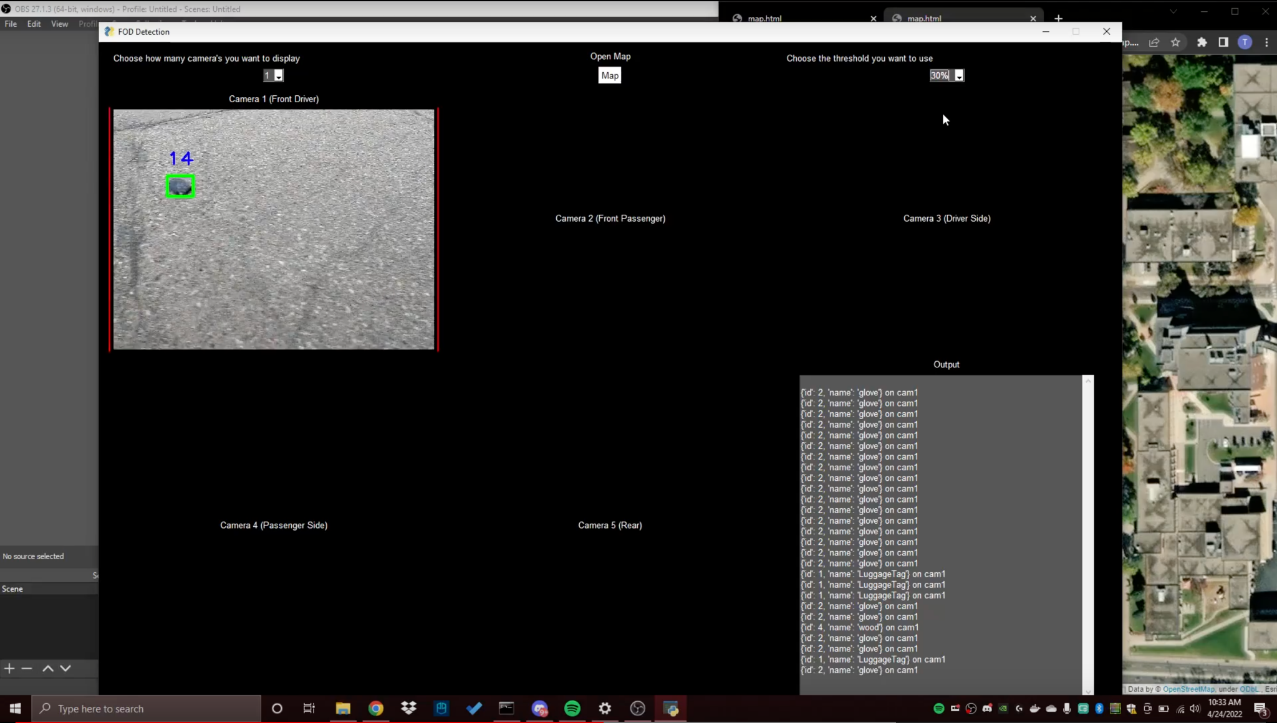
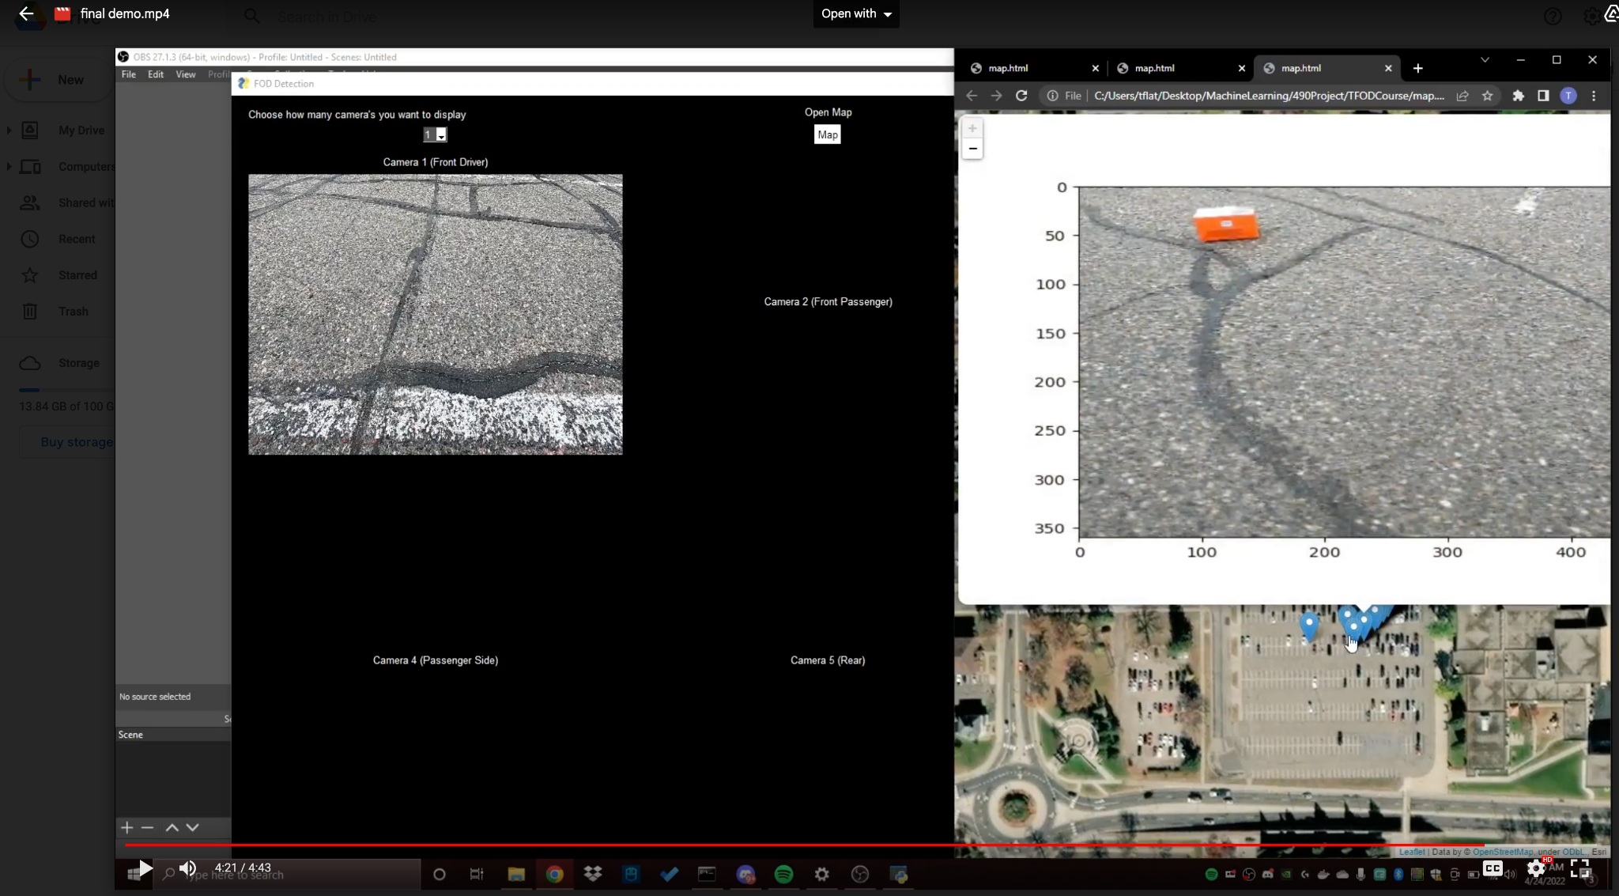

Slide 17
Planned Functionalities for Following Semester
Moving to the cloud
Streaming Infrastructure (gathering and handling footage from client browser)
Getting familiar with AWS or Azure
Refining our data model
Lowering inference speeds
Increase MAP and Decreasing Total Loss
More data
Expanding class labels
Multi-Camera Footage
Picking up USB and IP cameras
Analytics and map feature:
Complete map feature
Include means to analyze FOD trends (freq. Location, times, dates, types)
Notifications upon detection
Dist. Estimation:
Difficult feature: likely to use two cameras for stereo vision

Slide 18
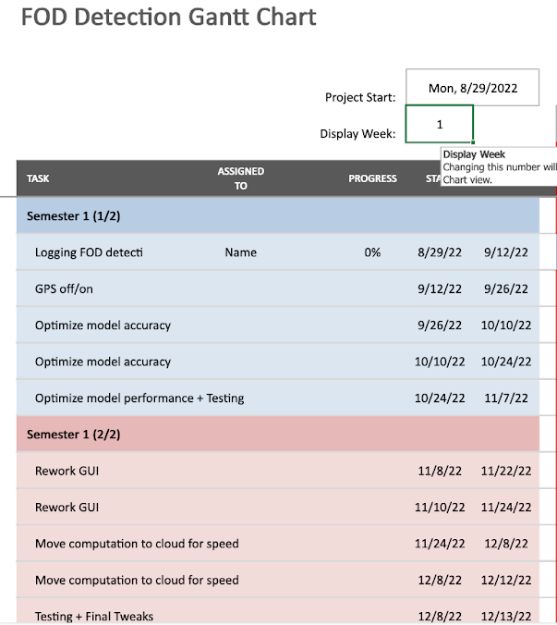
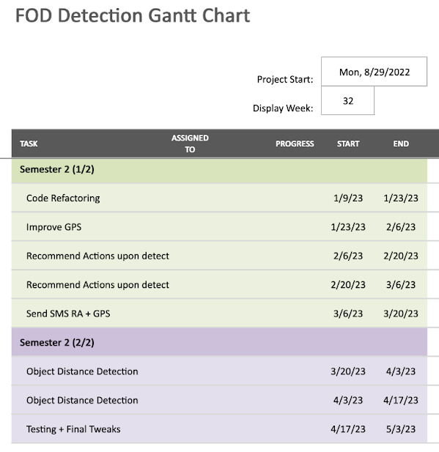
Original Gantt Chart

Slide 19
Work Achieved This Semester
Detection logging
GPS functionality can be disabled by client (some gps errors fixed)
Reduced inference latency and application start up times (nearly 45 second change!)
Bounding Box normalization
Web based GUI
Automated tests in Github CI
Reworked class labels and dataset
ML model training research and retraining
Overhaul of map functionality to be integrated into the GUI and the new functionalities
Automated aspects of preprocessing

Slide 20
Sprint 1 & 2 Breakdowns
Sprint 1
No FPS were assigned to task
Next week would use 1FP=2 hour
Task planned were vague topics and had odd function point values
Task completed:
Establishing an understanding of the project
Made preliminary Deployment Model and other models
Prototype detection logging functionality
Sprint 2
20/25 FPs planned
Last week of 2 hours = 1 FP, changed to 1 FP = 1 hour
More concrete goals but FP estimation was high this week
Task completed:
Improved process for setting up the program on a new computer
Refactoring code
GPS functionality can be turned on and off

Slide 21
Sprint 3 & 4 Breakdowns
Sprint 3
16/22 FP done + 4 FP in progress
FP assignment is accurate and task have a clear and understandable goal
Task completed:
Last sprint working on models and diagrams
Web based GUI prototype
Bounding box drawing made more efficient
Startup Time reduced by ~10 seconds or ~33%
Sprint 4
20/24.5 FP complete + 4.5FP in progress
Revisions to semester work plan for a more cohesive end point
Better organized trello board format
Task completed:
Began to research optimizing ML model
Create test cases + automated tests
FOD-A dataset adds many new training images

Slide 22
Sprint 5 & 6 Breakdowns
Sprint 5
22/31 FP complete + 6FP in progress
More FP than last week due to nearly finishing the previous workload
Task completed:
Prototype GUI is connected to project
API integration
ML Model research concluded and a retraining plan created
ML object detection labels finalized
Automated parts of test and training data preprocessing
Sprint 6
18/28 done
Thanksgiving break took away more time than expected
Task completed
Web based GUI no longer a prototype
Large overhaul of preexisting map functionality to be integrated with the GUI and new functionalities
Front end to back end connection nearly completed

Slide 23
Final week break down
No FPs Planned but work was done
Front end completely connected to back end
Image saving and display of detected FOD implemented
Other final changes to GUI and Map functionality
Model re-trained with the data we collected over the semester and with what we learned from the research

Slide 24
Obstacles faced
Delay getting project handoff and older groups source code and data
Difficulty learning tools. All of our first experience with DL. Many of our first experience with Python especially and a web environment
Very Hard to find tiny objects with Cv makes detecting small screws difficult
Colab policy change, began using compute units. Inconsistent cost per unit and inability to choose exact GPU to mitigate costs.
Difficulty streaming footage from client using websockets, will likely switch to webrtc to do this in the future. Solution has to run on local machine at the moment.
Issue replicating environment across team, will dockerize.

Slide 25
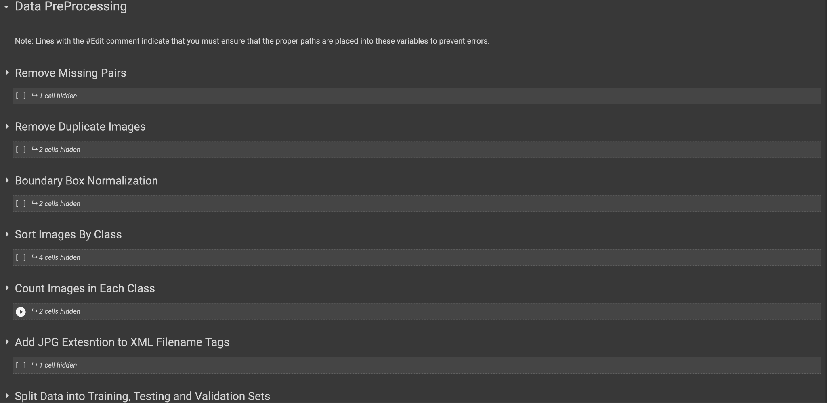
Our Jupyter Notebooks for Preprocessing

Slide 26
Preprocessing Data (cont.)
Smaller scripts were also built but not factored into our preprocessing pipeline
Many issues encountered during preprocessing stage
Negative boundary box values
Mislabeled bndbox as well as some that were far from their intended object
Unbalanced data
Data not sorted by class but instead all in test/train folder

Slide 27
Live Demo

Slide 28
Questions?

